Slide 1
Degital Design
에니그마 기계
Group 9 : 강성현, 김선규, 이재헌
Copyright ⓒ Slug. All right reserved.

Slide 2
CONTENTS
설계
구현
결과
Application
역할분배
Plug
신호 분석
독일군 암호
작동원리
Rotor
Enigma 암호화
해독 - Bombe
회로도
Reflector
Enigma 복호화
re_Rotor
Copyright ⓒ Slug. All right reserved.

Slide 3
설계
역할분배
작동원리
회로도
Copyright ⓒ Slug. All right reserved.

Slide 4
설계
역할분배
작동원리
회로도
강성현
김선규
이재헌
Copyright ⓒ Slug. All right reserved.

Slide 5
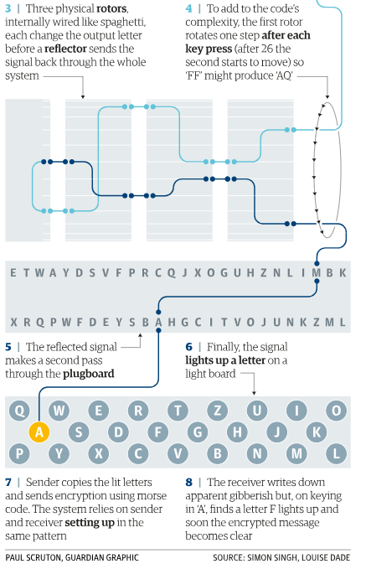
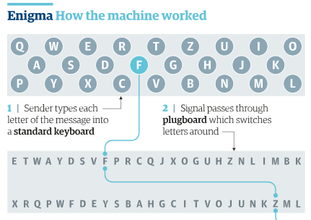
설계
작동원리
역할분배
회로도
Plug -> Rotor1 -> Rotor2 -> Rotor3
Plug <- Rotor1 <- Rotor2 -> Rotor3
Reflector
Hern, A. (2018). How did the Enigma machine work?. [online] the Guardian. Available at: https://www.theguardian.com/technology/2014/nov/14/how-did-enigma-machine-work-imitation-game [Accessed 5 Jun. 2018].
Copyright ⓒ Slug. All right reserved.

Slide 6
설계
작동원리
역할분배
회로도
Input : D
Plug -> Rotor1 -> Rotor2
Plug <- Rotor1 <- Rotor2
Reflector
B-A
K-M
L-Y
E-U
O-P
S-R
Plug
SETTING R1:3 R2:7
Z
Y
X
W
V
U
T
S
R
Q
P
O
N
M
L
K
J
I
H
G
F
E
D
C
B
A
R1
HYZLBKWENPTVRFIMACSUXOQDGJ
Z
Y
X
W
V
U
T
S
R
Q
P
O
N
M
L
K
J
I
H
G
F
E
D
C
B
A
R2
QGHXUYEALVIDJCRWMKOBFSPZTN
Reflector
Z
Y
X
W
V
U
T
S
R
Q
P
O
N
M
L
K
J
I
H
G
F
E
D
C
B
A
Copyright ⓒ Slug. All right reserved.
Copyright ⓒ Slug. All right reserved.
Copyright ⓒ Slug. All right reserved.

Slide 7
설계
작동원리
역할분배
회로도
Input : D
Plug -> Rotor1 -> Rotor2
Plug <- Rotor1 <- Rotor2
Reflector
B-A
K-M
L-Y
E-U
O-P
S-R
Plug
SETTING R1:3 R2:7
Z
Y
X
W
V
U
T
S
R
Q
P
O
N
M
L
K
J
I
H
G
F
E
D
C
B
A
R1
HYZLBKWENPTVRFIMACSUXOQDGJ
J
HYZLBKWENPTVRFIMACSUXOQDG
Z
Y
X
W
V
U
T
S
R
Q
P
O
N
M
L
K
J
I
H
G
F
E
D
C
B
A
R2
QGHXUYEALVIDJCRWMKOBFSPZTN
Reflector
Z
Y
X
W
V
U
T
S
R
Q
P
O
N
M
L
K
J
I
H
G
F
E
D
C
B
A
Copyright ⓒ Slug. All right reserved.
Copyright ⓒ Slug. All right reserved.
Copyright ⓒ Slug. All right reserved.

Slide 8
설계
작동원리
역할분배
회로도
Input : D
Plug -> Rotor1 -> Rotor2
Plug <- Rotor1 <- Rotor2
Reflector
B-A
K-M
L-Y
E-U
O-P
S-R
Plug
SETTING R1:3 R2:7
Z
Y
X
W
V
U
T
S
R
Q
P
O
N
M
L
K
J
I
H
G
F
E
D
C
B
A
R1
DGJ
HYZLBKWENPTVRFIMACSUXOQ
Z
Y
X
W
V
U
T
S
R
Q
P
O
N
M
L
K
J
I
H
G
F
E
D
C
B
A
R2
BFSPZTN
QGHXUYEALVIDJCRWMKO
Reflector
Z
Y
X
W
V
U
T
S
R
Q
P
O
N
M
L
K
J
I
H
G
F
E
D
C
B
A
Copyright ⓒ Slug. All right reserved.
Copyright ⓒ Slug. All right reserved.
Copyright ⓒ Slug. All right reserved.

Slide 9
설계
작동원리
역할분배
회로도
Input : D
Plug -> Rotor1 -> Rotor2
Plug <- Rotor1 <- Rotor2
Reflector
B-A
K-M
L-Y
E-U
O-P
S-R
Plug
SETTING R1:3 R2:7
D
Z
Y
X
W
V
U
T
S
R
Q
P
O
N
M
L
K
J
I
H
G
F
E
D
C
B
A
R1
DGJ
HYZLBKWENPTVRFIMACSUXOQ
Z
Y
X
W
V
U
T
S
R
Q
P
O
N
M
L
K
J
I
H
G
F
E
D
C
B
A
R2
BFSPZTN
QGHXUYEALVIDJCRWMKO
Reflector
Z
Y
X
W
V
U
T
S
R
Q
P
O
N
M
L
K
J
I
H
G
F
E
D
C
B
A
Copyright ⓒ Slug. All right reserved.
Copyright ⓒ Slug. All right reserved.
Copyright ⓒ Slug. All right reserved.

Slide 10
설계
작동원리
역할분배
회로도
Input : D
Plug -> Rotor1 -> Rotor2
Plug <- Rotor1 <- Rotor2
Reflector
B-A
K-M
L-Y
E-U
O-P
S-R
Plug
SETTING R1:3 R2:7
D
Z
Y
X
W
V
U
T
S
R
Q
P
O
N
M
L
K
J
I
H
G
F
E
D
C
B
A
R1
DGJ
HYZLBKWENPTVRFIMACSUXOQ
Z
Y
X
W
V
U
T
S
R
Q
P
O
N
M
L
K
J
I
H
G
F
E
D
C
B
A
R2
BFSPZTN
QGHXUYEALVIDJCRWMKO
Reflector
Z
Y
X
W
V
U
T
S
R
Q
P
O
N
M
L
K
J
I
H
G
F
E
D
C
B
A
Copyright ⓒ Slug. All right reserved.
Copyright ⓒ Slug. All right reserved.
Copyright ⓒ Slug. All right reserved.

Slide 11
설계
작동원리
역할분배
회로도
Input : D
Plug -> Rotor1 -> Rotor2
Plug <- Rotor1 <- Rotor2
Reflector
B-A
K-M
L-Y
E-U
O-P
S-R
Plug
SETTING R1:3 R2:7
D
Z
Y
X
W
V
U
T
S
R
Q
P
O
N
M
L
K
J
I
H
G
F
E
D
C
B
A
R1
DGJ
HYZLBKWENPTVRFIMACSUXOQ
Z
Y
X
W
V
U
T
S
R
Q
P
O
N
M
L
K
J
I
H
G
F
E
D
C
B
A
R2
BFSPZTN
QGHXUYEALVIDJCRWMKO
Reflector
Z
Y
X
W
V
U
T
S
R
Q
P
O
N
M
L
K
J
I
H
G
F
E
D
C
B
A
Copyright ⓒ Slug. All right reserved.
Copyright ⓒ Slug. All right reserved.
Copyright ⓒ Slug. All right reserved.

Slide 12
설계
작동원리
역할분배
회로도
Input : D
Plug -> Rotor1 -> Rotor2
Plug <- Rotor1 <- Rotor2
Reflector
B-A
K-M
L-Y
E-U
O-P
S-R
Plug
SETTING R1:3 R2:7
D
Z
Y
X
W
V
U
T
S
R
Q
P
O
N
M
L
K
J
I
H
G
F
E
D
C
B
A
R1
DGJ
HYZLBKWENPTVRFIMACSUXOQ
Z
Y
X
W
V
U
T
S
R
Q
P
O
N
M
L
K
J
I
H
G
F
E
D
C
B
A
R2
BFSPZTN
QGHXUYEALVIDJCRWMKO
Reflector
Z
Y
X
W
V
U
T
S
R
Q
P
O
N
M
L
K
J
I
H
G
F
E
D
C
B
A
Copyright ⓒ Slug. All right reserved.
Copyright ⓒ Slug. All right reserved.
Copyright ⓒ Slug. All right reserved.

Slide 13
설계
작동원리
역할분배
회로도
Input : D
Output : M
Plug -> Rotor1 -> Rotor2
Plug <- Rotor1 <- Rotor2
Reflector
B-A
K-M
L-Y
E-U
O-P
S-R
Plug
SETTING R1:3 R2:7
D
Z
Y
X
W
V
U
T
S
R
Q
P
O
N
M
L
K
J
I
H
G
F
E
D
C
B
A
R1
DGJ
HYZLBKWENPTVRFIMACSUXOQ
Z
Y
X
W
V
U
T
S
R
Q
P
O
N
M
L
K
J
I
H
G
F
E
D
C
B
A
R2
BFSPZTN
QGHXUYEALVIDJCRWMKO
Reflector
Z
Y
X
W
V
U
T
S
R
Q
P
O
N
M
L
K
J
I
H
G
F
E
D
C
B
A
Copyright ⓒ Slug. All right reserved.
Copyright ⓒ Slug. All right reserved.
Copyright ⓒ Slug. All right reserved.

Slide 14
설계
작동원리
역할분배
회로도
Input : D
Output : M
Plug -> Rotor1 -> Rotor2
Plug <- Rotor1 <- Rotor2
Reflector
B-A
K-M
L-Y
E-U
O-P
S-R
Plug
SETTING R1:3 R2:7
D
Z
Y
X
W
V
U
T
S
R
Q
P
O
N
M
L
K
J
I
H
G
F
E
D
C
B
A
R1
DGJ
HYZLBKWENPTVRFIMACSUXO
DGJ
HYZLBKWENPTVRFIMACSUXOQ
Q
Z
Y
X
W
V
U
T
S
R
Q
P
O
N
M
L
K
J
I
H
G
F
E
D
C
B
A
R2
BFSPZTN
QGHXUYEALVIDJCRWMKO
Reflector
Z
Y
X
W
V
U
T
S
R
Q
P
O
N
M
L
K
J
I
H
G
F
E
D
C
B
A
Copyright ⓒ Slug. All right reserved.
Copyright ⓒ Slug. All right reserved.
Copyright ⓒ Slug. All right reserved.

Slide 15
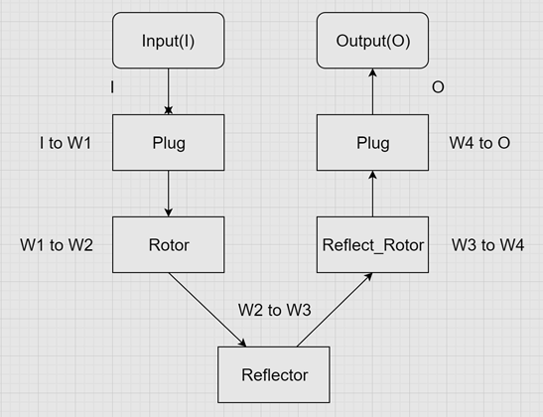
설계
역할분배
작동원리
회로도
(DMUX)
(DMUX)
(DMUX, Shift Register)
(DMUX, Shift Register)
(DMUX)
Copyright ⓒ Slug. All right reserved.

Slide 16
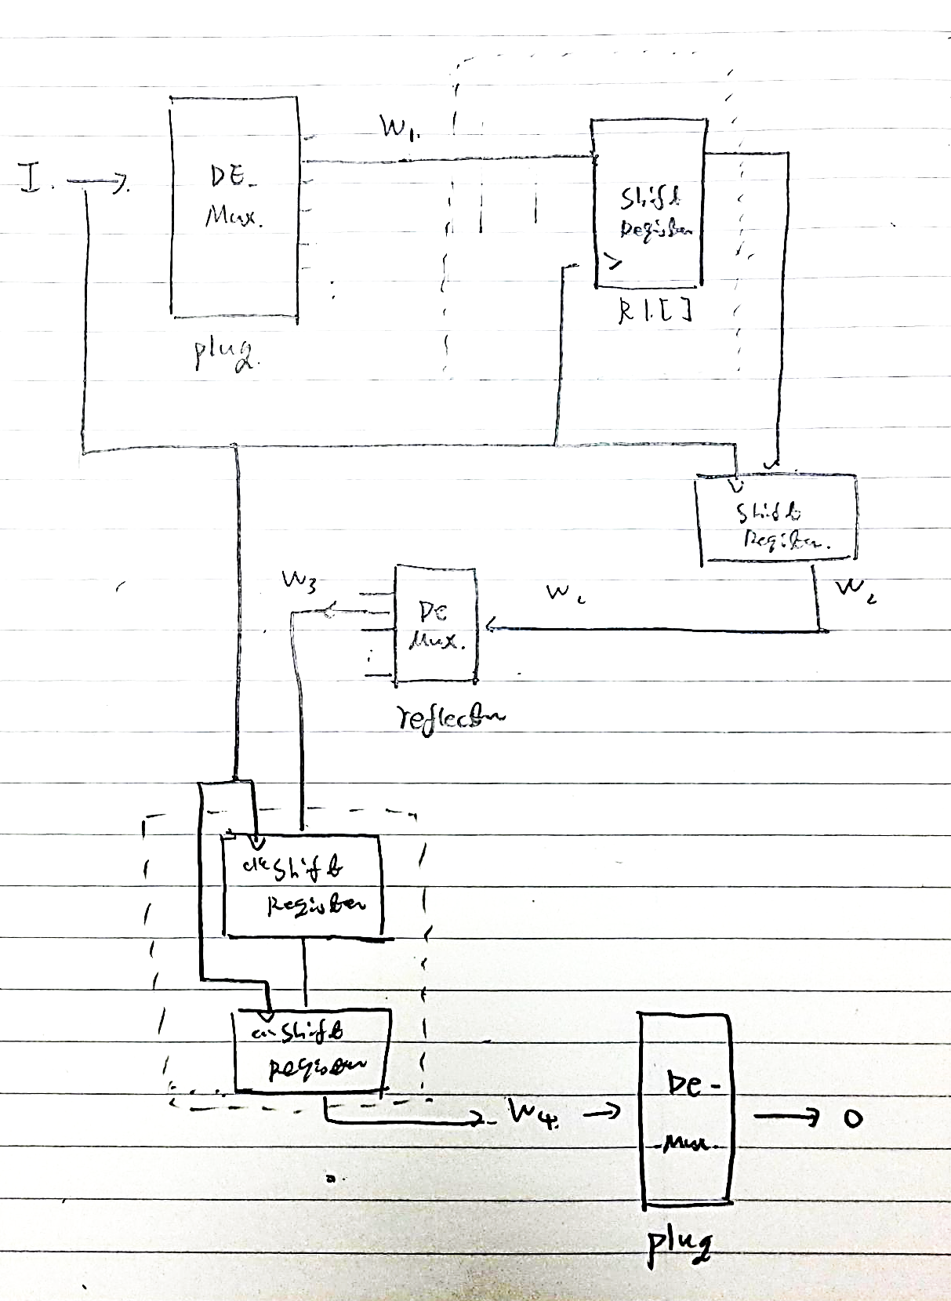
설계
역할분배
작동원리
회로도
Plug
Rotor
Reflector
Rotor
Plug
Copyright ⓒ Slug. All right reserved.

Slide 17
구현
Plug
Rotor
Reflector
re_Rotor
Copyright ⓒ Slug. All right reserved.

Slide 18
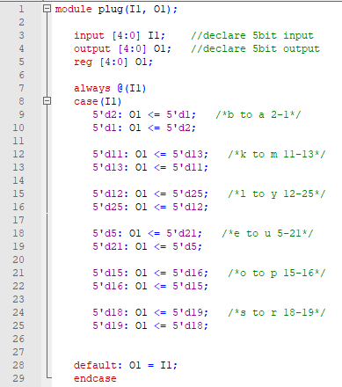
구현
Reflector
re_Rotor
Plug
Rotor
Module Plug
Behavior model
0 |  | 9 | I | 18 | R
1 | A | 10 | J | 19 | S
2 | B | 11 | K | 20 | T
3 | C | 12 | L | 21 | U
4 | D | 13 | M | 22 | V
5 | E | 14 | N | 23 | W
6 | F | 15 | O | 24 | X
7 | G | 16 | P | 25 | Y
8 | H | 17 | Q | 26 | Z
<Numeric Alphabet>
Copyright ⓒ Slug. All right reserved.

Slide 19
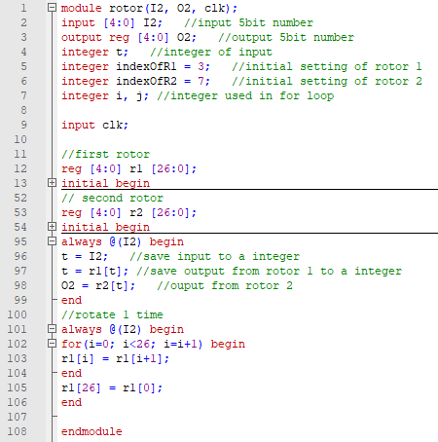
구현
Reflector
re_Rotor
Plug
Rotor
Module Rotor
Behavior model
Copyright ⓒ Slug. All right reserved.

Slide 20
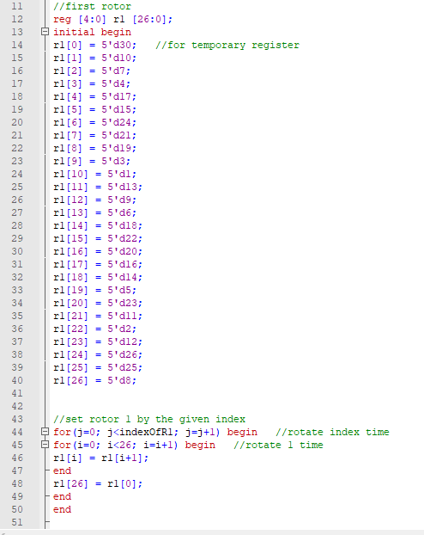
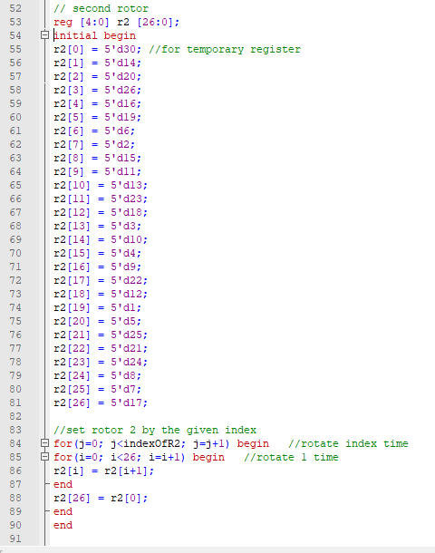
구현
Reflector
re_Rotor
Plug
Rotor
Module Rotor
Behavior model
Copyright ⓒ Slug. All right reserved.

Slide 21
구현
Reflector
re_Rotor
Plug
Rotor
Rotor
Reflector
입력값과 출력값이
같아질 수 없음!
Copyright ⓒ Slug. All right reserved.

Slide 22
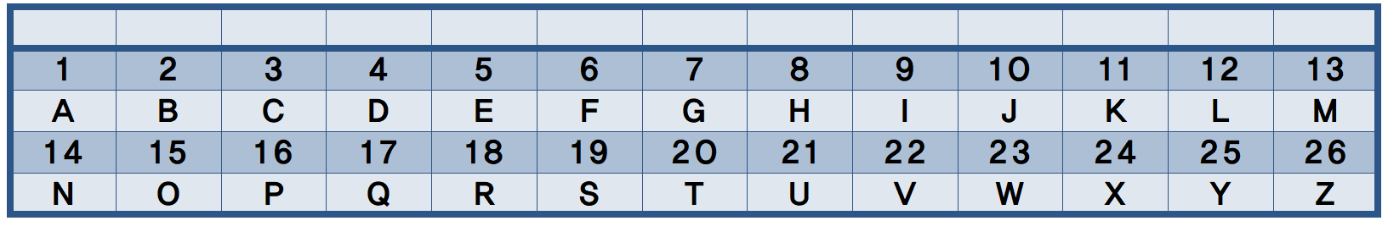
구현
Reflector
re_Rotor
Plug
Rotor

Slide 23
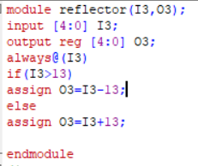
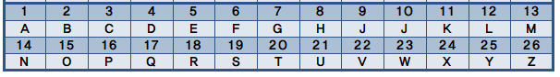
구현
Reflector
re_Rotor
Plug
Rotor
Copyright ⓒ Slug. All right reserved.

Slide 24
구현
Reflector
re_Rotor
Plug
Rotor
Copyright ⓒ Slug. All right reserved.

Slide 25
구현
Reflector
re_Rotor
Plug
Rotor
Rotor
input
output
Copyright ⓒ Slug. All right reserved.

Slide 26
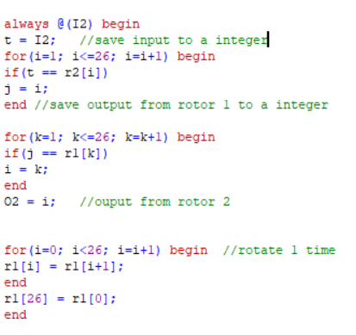
구현
Reflector
re_Rotor
Plug
Rotor

Slide 27
구현
Reflector
re_Rotor
Plug
Rotor
?
Enigma
평문
암호문

Slide 28
구현
Reflector
re_Rotor
Plug
Rotor
Input : D
Output : M
Plug -> Rotor1 -> Rotor2
Plug <- Rotor1 <- Rotor2
Reflector
B-A
K-M
L-Y
E-U
O-P
S-R
Plug
SETTING R1:3 R2:7
D
Z
Y
X
W
V
U
T
S
R
Q
P
O
N
M
L
K
J
I
H
G
F
E
D
C
B
A
R1
DGJ
HYZLBKWENPTVRFIMACSUXO
DGJ
HYZLBKWENPTVRFIMACSUXOQ
Q
Z
Y
X
W
V
U
T
S
R
Q
P
O
N
M
L
K
J
I
H
G
F
E
D
C
B
A
R2
BFSPZTN
QGHXUYEALVIDJCRWMKO
Reflector
Z
Y
X
W
V
U
T
S
R
Q
P
O
N
M
L
K
J
I
H
G
F
E
D
C
B
A
Copyright ⓒ Slug. All right reserved.
Copyright ⓒ Slug. All right reserved.
Copyright ⓒ Slug. All right reserved.

Slide 29
구현
Reflector
re_Rotor
Plug
Rotor
Input : D
Output : M
Plug -> Rotor1 -> Rotor2
Plug <- Rotor1 <- Rotor2
Reflector
B-A
K-M
L-Y
E-U
O-P
S-R
Plug
SETTING R1:3 R2:7
D
Z
Y
X
W
V
U
T
S
R
Q
P
O
N
M
L
K
J
I
H
G
F
E
D
C
B
A
R1
DGJ
HYZLBKWENPTVRFIMACSUXOQ
Z
Y
X
W
V
U
T
S
R
Q
P
O
N
M
L
K
J
I
H
G
F
E
D
C
B
A
R2
BFSPZTN
QGHXUYEALVIDJCRWMKO
Reflector
Z
Y
X
W
V
U
T
S
R
Q
P
O
N
M
L
K
J
I
H
G
F
E
D
C
B
A
Copyright ⓒ Slug. All right reserved.
Copyright ⓒ Slug. All right reserved.
Copyright ⓒ Slug. All right reserved.

Slide 30
구현
Reflector
re_Rotor
Plug
Rotor
Input : D
Plug -> Rotor1 -> Rotor2
Plug <- Rotor1 <- Rotor2
Reflector
B-A
K-M
L-Y
E-U
O-P
S-R
Plug
SETTING R1:3 R2:7
D
Z
Y
X
W
V
U
T
S
R
Q
P
O
N
M
L
K
J
I
H
G
F
E
D
C
B
A
R1
DGJ
HYZLBKWENPTVRFIMACSUXOQ
Z
Y
X
W
V
U
T
S
R
Q
P
O
N
M
L
K
J
I
H
G
F
E
D
C
B
A
R2
BFSPZTN
QGHXUYEALVIDJCRWMKO
Reflector
Z
Y
X
W
V
U
T
S
R
Q
P
O
N
M
L
K
J
I
H
G
F
E
D
C
B
A
Copyright ⓒ Slug. All right reserved.
Copyright ⓒ Slug. All right reserved.
Copyright ⓒ Slug. All right reserved.

Slide 31
구현
Reflector
re_Rotor
Plug
Rotor
Input : D
Plug -> Rotor1 -> Rotor2
Plug <- Rotor1 <- Rotor2
Reflector
B-A
K-M
L-Y
E-U
O-P
S-R
Plug
SETTING R1:3 R2:7
D
Z
Y
X
W
V
U
T
S
R
Q
P
O
N
M
L
K
J
I
H
G
F
E
D
C
B
A
R1
DGJ
HYZLBKWENPTVRFIMACSUXOQ
Z
Y
X
W
V
U
T
S
R
Q
P
O
N
M
L
K
J
I
H
G
F
E
D
C
B
A
R2
BFSPZTN
QGHXUYEALVIDJCRWMKO
Reflector
Z
Y
X
W
V
U
T
S
R
Q
P
O
N
M
L
K
J
I
H
G
F
E
D
C
B
A
Copyright ⓒ Slug. All right reserved.
Copyright ⓒ Slug. All right reserved.
Copyright ⓒ Slug. All right reserved.

Slide 32
구현
Reflector
re_Rotor
Plug
Rotor
Input : D
Plug -> Rotor1 -> Rotor2
Plug <- Rotor1 <- Rotor2
Reflector
B-A
K-M
L-Y
E-U
O-P
S-R
Plug
SETTING R1:3 R2:7
D
Z
Y
X
W
V
U
T
S
R
Q
P
O
N
M
L
K
J
I
H
G
F
E
D
C
B
A
R1
DGJ
HYZLBKWENPTVRFIMACSUXOQ
Z
Y
X
W
V
U
T
S
R
Q
P
O
N
M
L
K
J
I
H
G
F
E
D
C
B
A
R2
BFSPZTN
QGHXUYEALVIDJCRWMKO
Reflector
Z
Y
X
W
V
U
T
S
R
Q
P
O
N
M
L
K
J
I
H
G
F
E
D
C
B
A
Copyright ⓒ Slug. All right reserved.
Copyright ⓒ Slug. All right reserved.
Copyright ⓒ Slug. All right reserved.

Slide 33
구현
Reflector
re_Rotor
Plug
Rotor
Input : D
Plug -> Rotor1 -> Rotor2
Plug <- Rotor1 <- Rotor2
Reflector
B-A
K-M
L-Y
E-U
O-P
S-R
Plug
SETTING R1:3 R2:7
D
Z
Y
X
W
V
U
T
S
R
Q
P
O
N
M
L
K
J
I
H
G
F
E
D
C
B
A
R1
DGJ
HYZLBKWENPTVRFIMACSUXOQ
Z
Y
X
W
V
U
T
S
R
Q
P
O
N
M
L
K
J
I
H
G
F
E
D
C
B
A
R2
BFSPZTN
QGHXUYEALVIDJCRWMKO
Reflector
Z
Y
X
W
V
U
T
S
R
Q
P
O
N
M
L
K
J
I
H
G
F
E
D
C
B
A
Copyright ⓒ Slug. All right reserved.
Copyright ⓒ Slug. All right reserved.
Copyright ⓒ Slug. All right reserved.

Slide 34
구현
Reflector
re_Rotor
Plug
Rotor
Input : D
Plug -> Rotor1 -> Rotor2
Plug <- Rotor1 <- Rotor2
Reflector
B-A
K-M
L-Y
E-U
O-P
S-R
Plug
SETTING R1:3 R2:7
Z
Y
X
W
V
U
T
S
R
Q
P
O
N
M
L
K
J
I
H
G
F
E
D
C
B
A
R1
DGJ
HYZLBKWENPTVRFIMACSUXOQ
Z
Y
X
W
V
U
T
S
R
Q
P
O
N
M
L
K
J
I
H
G
F
E
D
C
B
A
R2
BFSPZTN
QGHXUYEALVIDJCRWMKO
Reflector
Z
Y
X
W
V
U
T
S
R
Q
P
O
N
M
L
K
J
I
H
G
F
E
D
C
B
A
Copyright ⓒ Slug. All right reserved.
Copyright ⓒ Slug. All right reserved.
Copyright ⓒ Slug. All right reserved.

Slide 35
결과
1. 신호 분석
2. Enigma 암호화
3. Enigma 해독
Copyright ⓒ Slug. All right reserved.

Slide 36
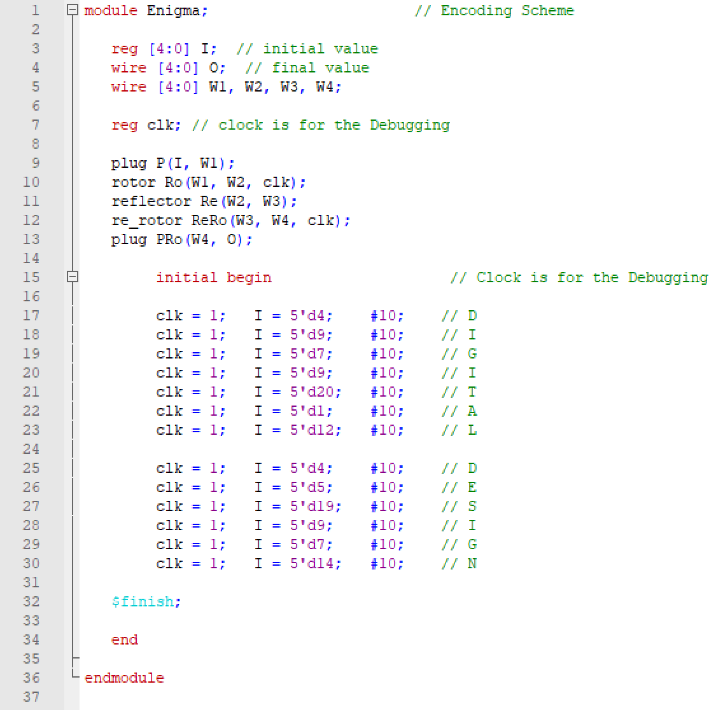
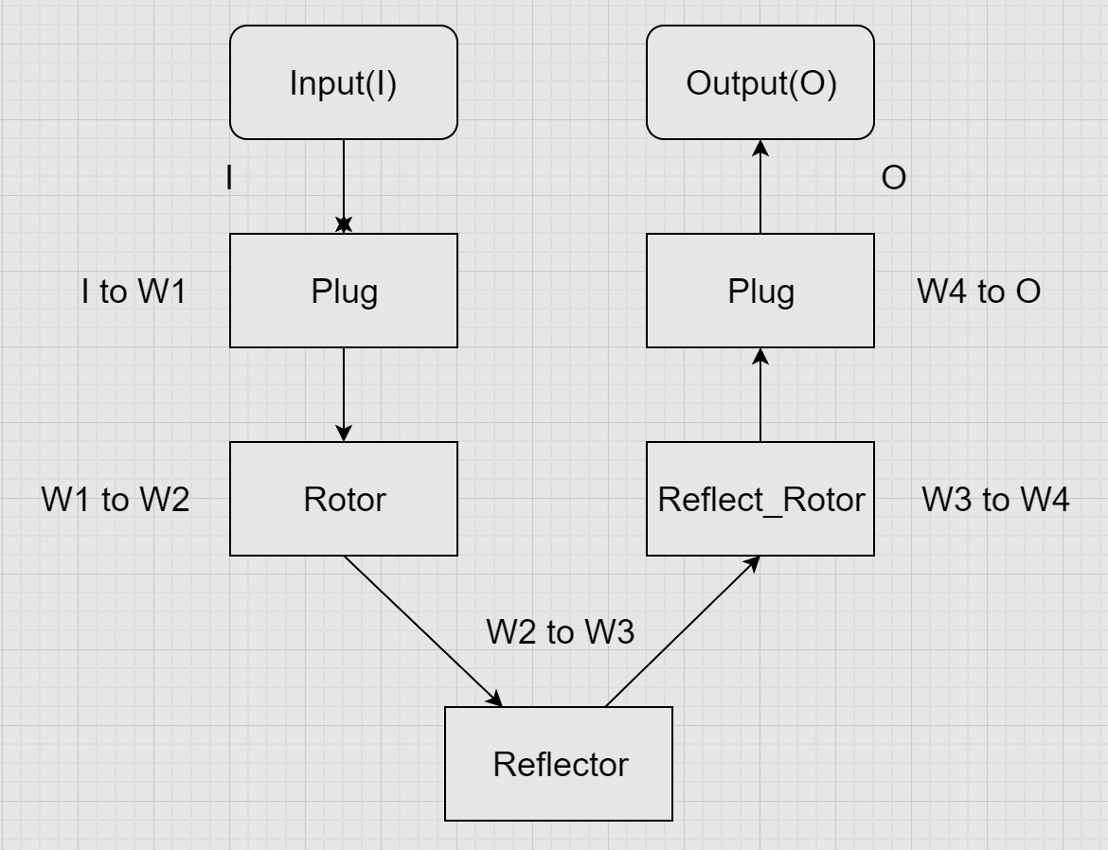
Results
1. 신호 분석
2. Enigma 암호화
3. Enigma 복호화
신호 분석 개요
Copyright ⓒ Slug. All right reserved.

Slide 37
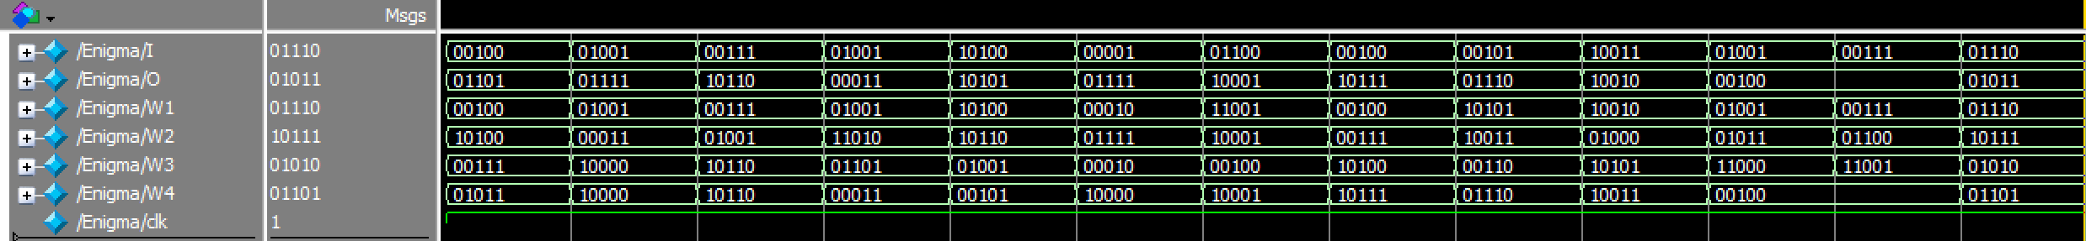
Results
1. 신호 분석
2. Enigma 암호화
3. Enigma 복호화
신호 분석 개요
D
I
G
I
T
A
L
D
E
S
I
G
N
W1
W4
I를 Plug에 집어넣었을 때 나오는 값
W3를 Re_Rotor에 집어넣었을 때 나오는 값
W2
O
W1을 Rotor에 집어넣었을 때 나오는 값
최종 결과
W3
W2을 Reflector에 집어넣었을 때 나오는 값
Copyright ⓒ Slug. All right reserved.

Slide 38
Results
1. 신호 분석
2. Enigma 암호화
3. Enigma 복호화
D
I
G
I
T
A
L
D
E
S
I
G
N
Encoding
Encoding D(00100)
I = input
I to W1: Plug
W1 to W2: Rotor
W2 to W3: Reflector
W3 to W4: Reflect_Rotor
W4 to O: Plug
O = output
I
00100
W4
01011
W1
00100
O
01101
W2
10100
W3
00111
The Result is M(01101)
Copyright ⓒ Slug. All right reserved.

Slide 39
Results
1. 신호 분석
2. Enigma 암호화
3. Enigma 복호화
M
I
G
I
T
A
L
D
E
S
I
G
N
Encoding
Encoding I(01001)
I = input
I to W1: Plug
W1 to W2: Rotor
W2 to W3: Reflector
W3 to W4: Reflect_Rotor
W4 to O: Plug
O = output
I
01001
W4
10000
W1
01001
O
01111
W2
00011
W3
10000
The Result is O(01111)
Copyright ⓒ Slug. All right reserved.

Slide 40
Results
1. 신호 분석
2. Enigma 암호화
3. Enigma 복호화
M
O
G
I
T
A
L
D
E
S
I
G
N
Encoding
Encoding G(00111)
I = input
I to W1: Plug
W1 to W2: Rotor
W2 to W3: Reflector
W3 to W4: Reflect_Rotor
W4 to O: Plug
O = output
I
00111
W4
10110
W1
00111
O
10110
W2
01001
W3
10110
The Result is V(10110)
Copyright ⓒ Slug. All right reserved.

Slide 41
Results
1. 신호 분석
2. Enigma 암호화
3. Enigma 복호화
M
O
V
I
T
A
L
D
E
S
I
G
N
Encoding
Encoding I(01001)
I = input
I to W1: Plug
W1 to W2: Rotor
W2 to W3: Reflector
W3 to W4: Reflect_Rotor
W4 to O: Plug
O = output
I
01001
W4
00011
W1
01001
O
00011
W2
11010
W3
01101
The Result is C(00011)
Copyright ⓒ Slug. All right reserved.

Slide 42
Results
1. 신호 분석
2. Enigma 암호화
3. Enigma 복호화
M
O
V
C
T
A
L
D
E
S
I
G
N
Encoding
Encoding T(10100)
I = input
I to W1: Plug
W1 to W2: Rotor
W2 to W3: Reflector
W3 to W4: Reflect_Rotor
W4 to O: Plug
O = output
I
10100
W4
00101
W1
10100
O
10101
W2
10110
W3
01001
The Result is U(10101)
Copyright ⓒ Slug. All right reserved.

Slide 43
Results
1. 신호 분석
2. Enigma 암호화
3. Enigma 복호화
M
O
V
C
U
A
L
D
E
S
I
G
N
Encoding
Encoding A(00001)
I = input
I to W1: Plug
W1 to W2: Rotor
W2 to W3: Reflector
W3 to W4: Reflect_Rotor
W4 to O: Plug
O = output
I
00001
W4
10000
W1
00010
O
01111
W2
01111
W3
00010
The Result is O(01111)
Copyright ⓒ Slug. All right reserved.

Slide 44
Results
1. 신호 분석
2. Enigma 암호화
3. Enigma 복호화
M
O
V
C
U
O
L
D
E
S
I
G
N
Encoding
Encoding L(01100)
I = input
I to W1: Plug
W1 to W2: Rotor
W2 to W3: Reflector
W3 to W4: Reflect_Rotor
W4 to O: Plug
O = output
I
01100
W4
10001
W1
11001
O
10001
W2
10001
W3
00100
The Result is Q(10001)
Copyright ⓒ Slug. All right reserved.

Slide 45
Results
1. 신호 분석
2. Enigma 암호화
3. Enigma 복호화
M
O
V
C
U
O
Q
D
E
S
I
G
N
Encoding
Encoding D(00100)
I = input
I to W1: Plug
W1 to W2: Rotor
W2 to W3: Reflector
W3 to W4: Reflect_Rotor
W4 to O: Plug
O = output
I
00100
W4
10111
W1
00100
O
10111
W2
00111
W3
10100
The Result is W(10111)
Copyright ⓒ Slug. All right reserved.

Slide 46
Results
1. 신호 분석
2. Enigma 암호화
3. Enigma 복호화
M
O
V
C
U
O
Q
W
E
S
I
G
N
Encoding
Encoding N(00101)
I = input
I to W1: Plug
W1 to W2: Rotor
W2 to W3: Reflector
W3 to W4: Reflect_Rotor
W4 to O: Plug
O = output
I
00101
W4
01110
W1
10101
O
01110
W2
10011
W3
00110
The Result is N(01110)
Copyright ⓒ Slug. All right reserved.

Slide 47
Results
1. 신호 분석
2. Enigma 암호화
3. Enigma 복호화
M
O
V
C
U
O
Q
W
N
S
I
G
N
Encoding
Encoding S(10011)
I = input
I to W1: Plug
W1 to W2: Rotor
W2 to W3: Reflector
W3 to W4: Reflect_Rotor
W4 to O: Plug
O = output
I
10011
W4
10011
W1
10010
O
10010
W2
01000
W3
10101
The Result is R(10010)
Copyright ⓒ Slug. All right reserved.

Slide 48
Results
1. 신호 분석
2. Enigma 암호화
3. Enigma 복호화
M
O
V
C
U
O
Q
W
N
R
I
G
N
Encoding
Encoding I(01001)
I = input
I to W1: Plug
W1 to W2: Rotor
W2 to W3: Reflector
W3 to W4: Reflect_Rotor
W4 to O: Plug
O = output
I
01001
W4
00100
W1
01001
O
00100
W2
01011
W3
11000
The Result is D(00100)
Copyright ⓒ Slug. All right reserved.

Slide 49
Results
1. 신호 분석
2. Enigma 암호화
3. Enigma 복호화
M
O
V
C
U
O
Q
W
N
R
D
G
N
Encoding
Encoding G(00111)
I = input
I to W1: Plug
W1 to W2: Rotor
W2 to W3: Reflector
W3 to W4: Reflect_Rotor
W4 to O: Plug
O = output
I
00111
W4
00100
W1
00111
O
00100
W2
01100
W3
11001
The Result is D(00100)
Copyright ⓒ Slug. All right reserved.

Slide 50
Results
1. 신호 분석
2. Enigma 암호화
3. Enigma 복호화
M
O
V
C
U
O
Q
W
N
R
D
D
N
Encoding
Encoding N(01110)
I = input
I to W1: Plug
W1 to W2: Rotor
W2 to W3: Reflector
W3 to W4: Reflect_Rotor
W4 to O: Plug
O = output
I
01110
W4
01101
W1
01110
O
01011
W2
10111
W3
01010
The Result is K(01011)
Copyright ⓒ Slug. All right reserved.

Slide 51
Results
1. 신호 분석
2. Enigma 암호화
3. Enigma 복호화
M
O
V
C
U
O
Q
W
N
R
D
D
K
Copyright ⓒ Slug. All right reserved.

Slide 52
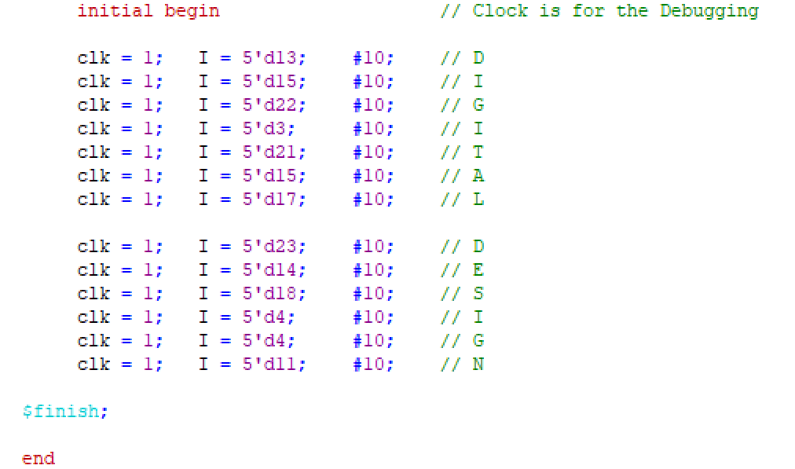
Results
1. 신호 분석
2. Enigma 암호화
3. Enigma 복호화
신호 분석 개요
복호화
복호화를 하기 위해 종전에 암호화한 값을 순서대로 넣었다.
Copyright ⓒ Slug. All right reserved.

Slide 53
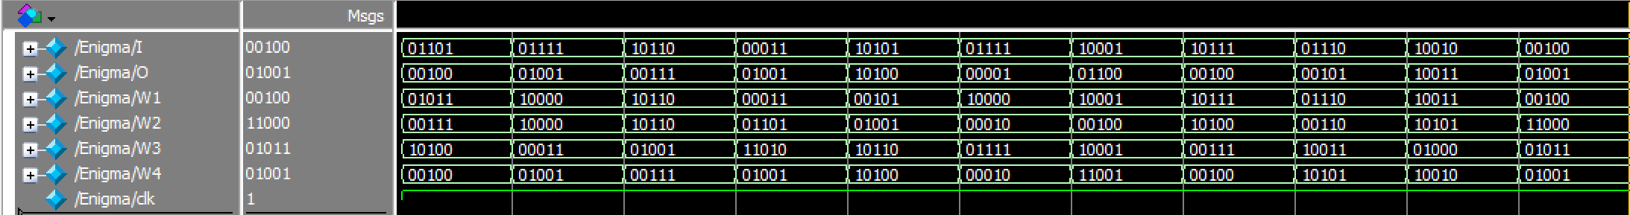
Results
1. 신호 분석
2. Enigma 암호화
3. Enigma 복호화
Decoding
Decoding M(01101)
I = input
I to W1: Plug
W1 to W2: Rotor
W2 to W3: Reflector
W3 to W4: Reflect_Rotor
W4 to O: Plug
O = output
I
01101
W4
00100
W1
01011
O
00100
W2
00111
W3
10100
The Result is D(00100)
Copyright ⓒ Slug. All right reserved.

Slide 54
Results
1. 신호 분석
2. Enigma 암호화
3. Enigma 복호화
D
Decoding
Decoding O(01111)
I = input
I to W1: Plug
W1 to W2: Rotor
W2 to W3: Reflector
W3 to W4: Reflect_Rotor
W4 to O: Plug
O = output
I
01111
W4
01001
W1
10000
O
01001
W2
10000
W3
00011
The Result is I(01001)
Copyright ⓒ Slug. All right reserved.

Slide 55
Results
1. 신호 분석
2. Enigma 암호화
3. Enigma 복호화
D
I
Decoding
Decoding V(10110)
I = input
I to W1: Plug
W1 to W2: Rotor
W2 to W3: Reflector
W3 to W4: Reflect_Rotor
W4 to O: Plug
O = output
I
10110
W4
00111
W1
10110
O
00111
W2
10110
W3
01001
The Result is G(00111)
Copyright ⓒ Slug. All right reserved.

Slide 56
Results
1. 신호 분석
2. Enigma 암호화
3. Enigma 복호화
D
I
G
Decoding
Decoding C(00011)
I = input
I to W1: Plug
W1 to W2: Rotor
W2 to W3: Reflector
W3 to W4: Reflect_Rotor
W4 to O: Plug
O = output
I
00011
W4
01001
W1
00011
O
01001
W2
01101
W3
11010
The Result is I(01001)
Copyright ⓒ Slug. All right reserved.

Slide 57
Results
1. 신호 분석
2. Enigma 암호화
3. Enigma 복호화
D
I
G
I
Decoding
Decoding U(10101)
I = input
I to W1: Plug
W1 to W2: Rotor
W2 to W3: Reflector
W3 to W4: Reflect_Rotor
W4 to O: Plug
O = output
I
10101
W4
10100
W1
00101
O
10100
W2
01001
W3
10110
The Result is T(10100)
Copyright ⓒ Slug. All right reserved.

Slide 58
Results
1. 신호 분석
2. Enigma 암호화
3. Enigma 복호화
D
I
G
I
T
Decoding
Decoding O(01111)
I = input
I to W1: Plug
W1 to W2: Rotor
W2 to W3: Reflector
W3 to W4: Reflect_Rotor
W4 to O: Plug
O = output
I
01111
W4
00010
W1
10000
O
00001
W2
00010
W3
01111
The Result is A(00001)
Copyright ⓒ Slug. All right reserved.

Slide 59
Results
1. 신호 분석
2. Enigma 암호화
3. Enigma 복호화
D
I
G
I
T
A
Decoding
Decoding Q(10001)
I = input
I to W1: Plug
W1 to W2: Rotor
W2 to W3: Reflector
W3 to W4: Reflect_Rotor
W4 to O: Plug
O = output
I
10001
W4
11001
W1
10001
O
01100
W2
00100
W3
10001
The Result is L(01100)
Copyright ⓒ Slug. All right reserved.

Slide 60
Results
1. 신호 분석
2. Enigma 암호화
3. Enigma 복호화
D
I
G
I
T
A
L
Decoding
Decoding W(10111)
I = input
I to W1: Plug
W1 to W2: Rotor
W2 to W3: Reflector
W3 to W4: Reflect_Rotor
W4 to O: Plug
O = output
I
10111
W4
00100
W1
10111
O
00100
W2
10100
W3
00111
The Result is D(00100)
Copyright ⓒ Slug. All right reserved.

Slide 61
Results
1. 신호 분석
2. Enigma 암호화
3. Enigma 복호화
D
I
G
I
T
A
L
D
Decoding
Decoding N(01110)
I = input
I to W1: Plug
W1 to W2: Rotor
W2 to W3: Reflector
W3 to W4: Reflect_Rotor
W4 to O: Plug
O = output
I
01110
W4
10101
W1
01110
O
00101
W2
00110
W3
10011
The Result is E(00101)
Copyright ⓒ Slug. All right reserved.

Slide 62
Results
1. 신호 분석
2. Enigma 암호화
3. Enigma 복호화
D
I
G
I
T
A
L
D
E
Decoding
Decoding R(10010)
I = input
I to W1: Plug
W1 to W2: Rotor
W2 to W3: Reflector
W3 to W4: Reflect_Rotor
W4 to O: Plug
O = output
I
10010
W4
10010
W1
10011
O
10011
W2
10101
W3
01000
The Result is S(10011)
Copyright ⓒ Slug. All right reserved.

Slide 63
Results
1. 신호 분석
2. Enigma 암호화
3. Enigma 복호화
D
I
G
I
T
A
L
D
E
S
Decoding
Decoding D(00100)
I = input
I to W1: Plug
W1 to W2: Rotor
W2 to W3: Reflector
W3 to W4: Reflect_Rotor
W4 to O: Plug
O = output
I
00100
W4
01001
W1
00100
O
01001
W2
11000
W3
01011
The Result is I(01001)
Copyright ⓒ Slug. All right reserved.

Slide 64
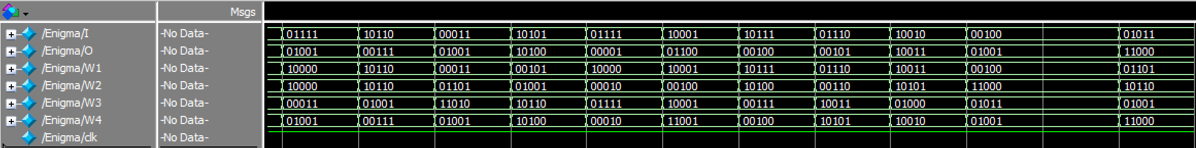
Results
1. 신호 분석
2. Enigma 암호화
3. Enigma 복호화
I
G
I
T
A
L
D
E
S
I
Decoding
Decoding ???
I = input
I to W1: Plug
W1 to W2: Rotor
W2 to W3: Reflector
W3 to W4: Reflect_Rotor
W4 to O: Plug
O = output
I
?
W4
?
W1
?
O
?
W2
?
W3
?
The Result is ???
Copyright ⓒ Slug. All right reserved.

Slide 65
한계
1. 중복된 글자를 못 받음
많은 방법들을 시도하였으나, 구조상 결함으로 인해 중복된 글자를 암호화/복호화하지 못한다
중복된 글자를 못 받음
로터가 2개
로터 위치 변환이 어려움
2. 로터가 2개라 쉽게 뚫림
2개의 로터에서 생기는 경우의 수는 1352가지, 턱없이 적다.
구조상의 결함으로 인해 중복된
글자를 받을 시 로터가 정상적으로 돌아가지 않는다.
로터만 따지면, 총 경우의 수가
26*26*2! = 1352가지
각각의 로터로 지정된 r1, r2를 전부 r2, r1으로 변경해야 한다
3. 로터 위치 변환 어려움
이를 바꾸기 위해서는 코드를 뜯어내서 바꾸어야 한다.
Copyright ⓒ Slug. All right reserved.

Slide 66
Application
1. 독일군 암호
2. 해독 - 봄브
Copyright ⓒ Slug. All right reserved.

Slide 67
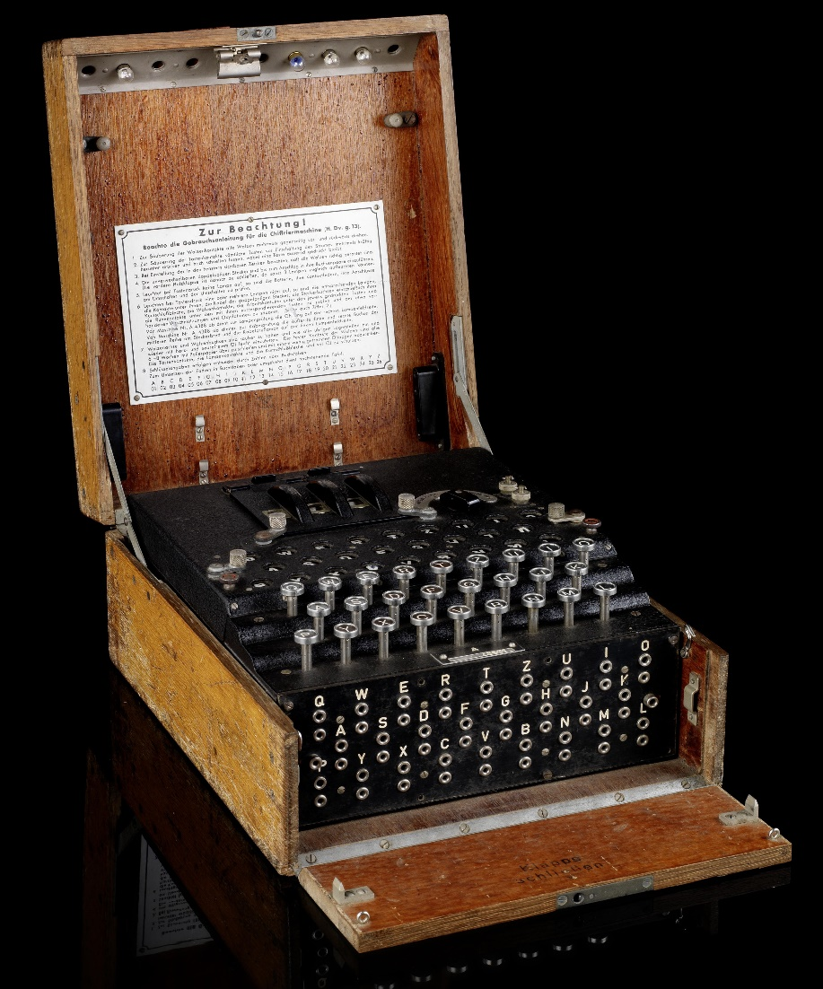
Application
1. 독일군 암호
2. 해독 - 봄브
에니그마 기계
(Enigma Machine)
-세계 2차 대전에 사용된 암호화 기계.
-1926년 독일 군대에서 처음 사용되었다.
-전기 기사 아르투르 세르비우스가 최초의 에니그마 모델을 개발했다.. 이는 상품화되었고, 전쟁이 시작한 후 독일군의 암호 기계로 채택되었다.
*잭 첼로너, <<죽기 전에 꼭 알아야 할 세상을 바꾼 발명품 1001>>, 마로니에북스, 2010
Copyright ⓒ Slug. All right reserved.

Slide 68
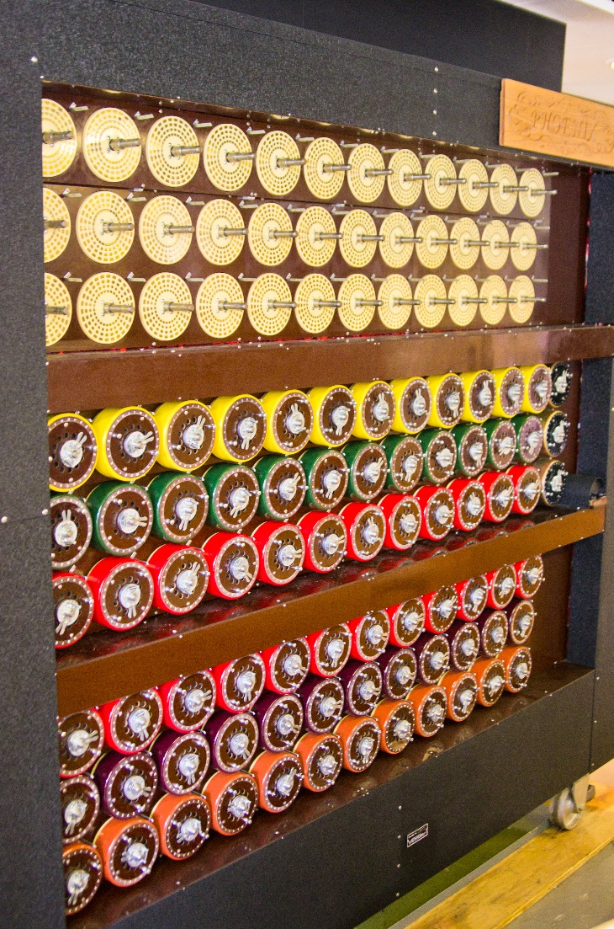
Application
1. 독일군 암호
2. 해독 - 봄브
에니그마 암호의 해독 - 봄브
(British Bombe)
-영국의 Bletchley Park에서 에니그마 해독을 위해 발명한 기계이다.
-1940년 8월에 엘런 튜링(Alan Turing)을 중심으로 하여 완성하였고, 연합군의 승리에 기여했다.
-이는 현대의 기계적 컴퓨터의 초석이 되었다.
*잭 첼로너, <<죽기 전에 꼭 알아야 할 세상을 바꾼 발명품 1001>>, 마로니에북스, 2010
Copyright ⓒ Slug. All right reserved.

Slide 69
감사합니다
이상 9조입니다
Copyright ⓒ Slug. All right reserved.

